Slide 1
March report
Sanjay Madria

Slide 2
Demo setup for ReVo-ABE based secure DTN communication
Brief review
Communication options
Security library
Design of ReVo-ABE modules

Slide 3
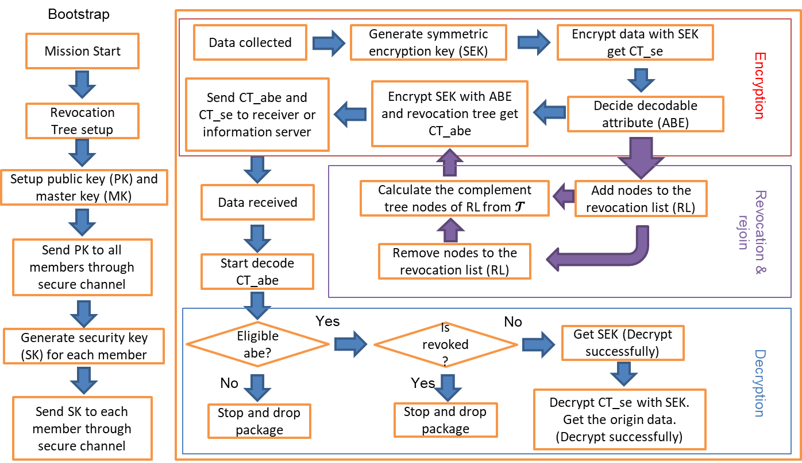
Brief review – flow chart of ReVo-ABE

Slide 4
Communication options
Bluetooth
Communication range is less than 30 meters
Require handshake before connection
Could pair with multiple devices
Has low energy options (BLE)
Wi-Fi
Communication range is about 30 meters
Require handshake before connection
Could achieve broadcast through SSID broadcast
Wi-Fi hotspot could connect up to 10 devices
Notes:
When designing the DTN demo in android devices, Bluetooth and Google Nearby Connections API are considered. These devices referred to as nodes form a Delay Tolerant Network (DTN), also known as an opportunistic network. As suggested by its name, DTN can tolerate delays and significant loss of data while forwarding a message from source to destination using store and forward paradigm. In DTN, it is of critical importance that the network is not completely flooded and also the message is not tampered or corrupted and readable only to the destined node.

Slide 5
Communication options – API
Google Nearby connect API:
It is an API developed by Google for making peer-to-peer networking with Android devices simple and secure and performing data transfers at a high bandwidth.
It support all common hardware like Bluetooth, Bluetooth low energy (BLE) and Wi-Fi hotspots.
It performs advertising, discovery, and connections with nearby devices in a fully offline peer-to-peer manner.
based on a connection with a nearby device, it automatically decides whether to use Bluetooth or Wi-Fi Hotspots and end-user intervention is not needed to switch them on.

Slide 6
Security library for Android
Java Pairing-Based Cryptography (JPBC)
It is an open-source library and in our implementation.
It is used to create public and security keys using Elliptical Cryptography.
JPBC runs out of box on Android (2.1+ version).

Slide 7
Design of ReVo-ABE modules – Key handler
The server generates a master key and a public key and send the public key to all the nodes in the network through a security channel. Then it generates the security key for all the nodes and send to them separately.
whenever a device creates a new message, it creates a random symmetric key of size 256 bits using Advanced Encryption Standard (AES) which will be used to encrypt the message. The AES key is then encrypted by ReVo-ABE with the group attributes and revocation list.

Slide 8
Design of ReVo-ABE modules – Revocation List handler
We designed the revocation list handler that periodically broadcasting revocation list hash to the network.
Once the hash is different from the current nodes, that nodes will fetch the newest encrypted revocation list from the server.

Slide 9
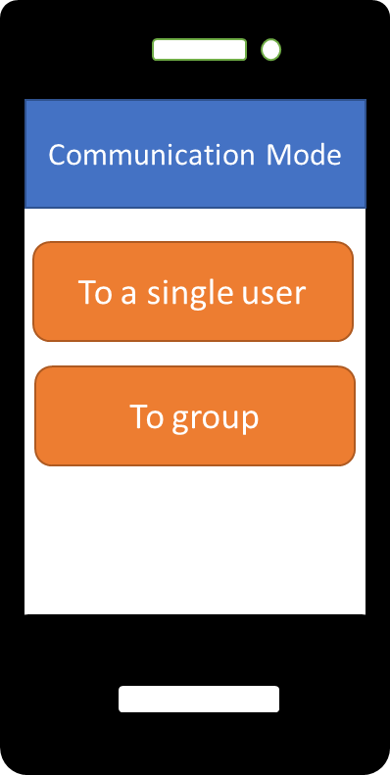
Design of ReVo-ABE modules – Data flow between connected devices
There are two communication mode for ReVo-ABE demo. The pair communication and the group communication.
User can choose the mode they prefer.
The pair communication could allow the use to send the message to the target directly.
The group communication allows the user to send the message to all the nearby nodes.

Slide 10
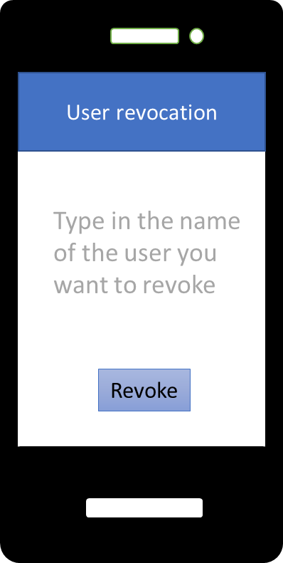
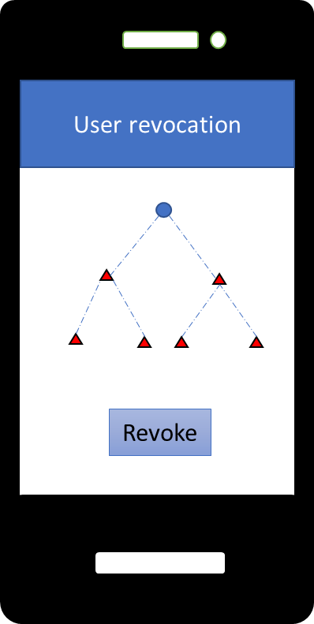
Design of ReVo-ABE modules – user revocation
The app could allow the user to choose who to revoke and when to revoke.
Data owner can revoke other users by type in their name or choose from a predefined revocation tree.

Slide 11
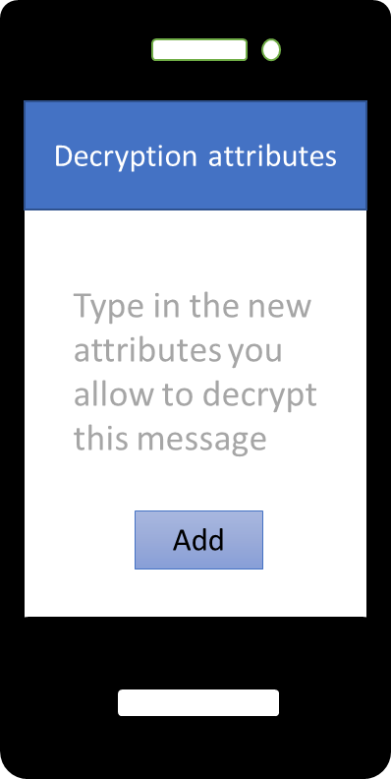
Design of ReVo-ABE modules – user join
In the demo, the app could allow the user to add new member in the group dynamically while still maintain security.
To let a user join, the data owner needs to add the new user’s attribute to the attribute tree.
When encrypt, the data owner needs to make sure the new user is not in the revocation list.

Slide 12
Content Caching for DTN network
Problem Statement and goal
System model
Objectives
Simulation and results

Slide 13
Problem Statement
A message needs to be forwarded to a set of nodes who have higher interest similarity with this message. Besides, messages need to be forwarded to the CC also as many as possible.
While forwarding messages, congestion may occur to the nodes with high mobility and contacts.
Different events lead to different topic as trending or important. These need to be identified and quickly dispersed.
Due to limited bandwidth and intermittent connection among the node in a DTN, content transmission from further node causes long-transmission delay which can be handled by efficient cache management.
As nodes also move, their trajectories need to be analyzed in deciding what content to cache in which node.

Slide 14
Goal
Content prioritization in the response of an event. Nodes continuously collect information from messages received to detect trending topics to identify prioritized messages to deliver them first.
Satisfying nodes' own mission interest while disseminating messages to the appropriate nodes selected by the RL method.
Interest adjustment among the nodes based on their contact patterns with other nodes to increase the overall message delivery.
Congestion avoidance with respect to a busy node to reduce message drop rate and link breaks.
Providing a resource-aware collaborative cache management scheme to increase the content accessibility among the nodes.

Slide 15
System Model
All nodes have different lists of interests.
Each message is associated with a list of keywords.
All nodes can generate, forward and delete message.
The command center is the final destination of all generated messages.
On contact, two nodes can exchange information about each other interests, delivery probability, and current congestion situation, etc. metadata.

Slide 16
Objective 1: Priority Content Delivery
Some content may have more priority due to an event and forwarding them to the CC needs to be fast.
We propose to detect the content with higher priority and transfer them among the nodes as much as possible so that those content will be delivered to the CC and nodes quickly and everyone will be aware of the incident.
However, priority content may become less important after some time, and hence our approach can handle this issue by emphasizing more on content generated in recent time slots than previous time slots.

Slide 17
Objective 2: Providing Content by Interest
Node’s storage, energy, and bandwidth is limited. So, a node cannot store and transmit/receive all the content.
We propose to forward content to a node based on its interest which is defined by its mission.
We measure the similarity of a content message with the interest of a node before forwarding so that it will fulfill the node’s interest.
For increased message delivery, we propose a RL based approach to adjust nodes interests so that they will be able to carry each other messages if frequently connected.

Slide 18
Congestion Handling
Data congestion in the nodes leads to more energy consumption due to transmission and more packet drops due to limited storage which can harm the overall performance of the network.
The congestion state of the nodes can vary based on the contact pattern and connection time with the other nodes.
Hence, we propose to learn the congestion nature of the nodes using RL and act accordingly so that nodes moving to the congested state will receive a reduced amount of data until they receive usual flow of content.

Slide 19
Objective 3: Cache Management
Cache nodes can store huge content for other nodes and the content are always changing. This situation cannot be dealt with traditional Q-learning. Hence, we propose Deep Q Network (DQN) to handle the continuous state-action space.
In stationary scenario, transmission delay is considered as the key parameter while learning cache management. In our scenario, delay depends on the opportunity of nodes’ contact. Hence, transmission delay is measured with the time and hop needed to forward content to a node.
Nodes usually moves in a team for achieving same mission goal. A cache hit is considered when a team member receives the content for his other team member because they are supposed to be in closed vicinity.

Slide 20
Objective 4: Trajectory Prediction
The possibility of a node being found in a region depends on its previous visit frequency and time duration of staying in that region which is called zone of stay (ZoS).
The network area can be divided in grids and nodes zone of stay in a particular grid can be learned using RL.
Stationary/intra-region cache nodes can use the ZoS information to store content for the nodes which are most likely to visit the surrounding area.
However, nodes are usually mobile and may traverse within a wide range of grids which make cache decision more difficult. Hence cache nodes also need to consider their own ZoS along with their previous contact pattern to the other nodes while caching content for those other nodes.

Slide 21
Simulation
We perform simulations on ONE simulator with 131 nodes. These nodes are mobile and capable of transferring messages when they are within the communication range.
We use the following two datasets for the simulation.
Asturies dataset (AST): This dataset contains one year long GPS traces collected from the regional Fire Department of Asturias, Spain.
EPFL mobility dataset (EPFL): This dataset contains mobility of 500 taxis over 30 days in an Francisco Bay Area, USA.
We show the characteristics of the dataset on varying resources in the next two slides.

Slide 22
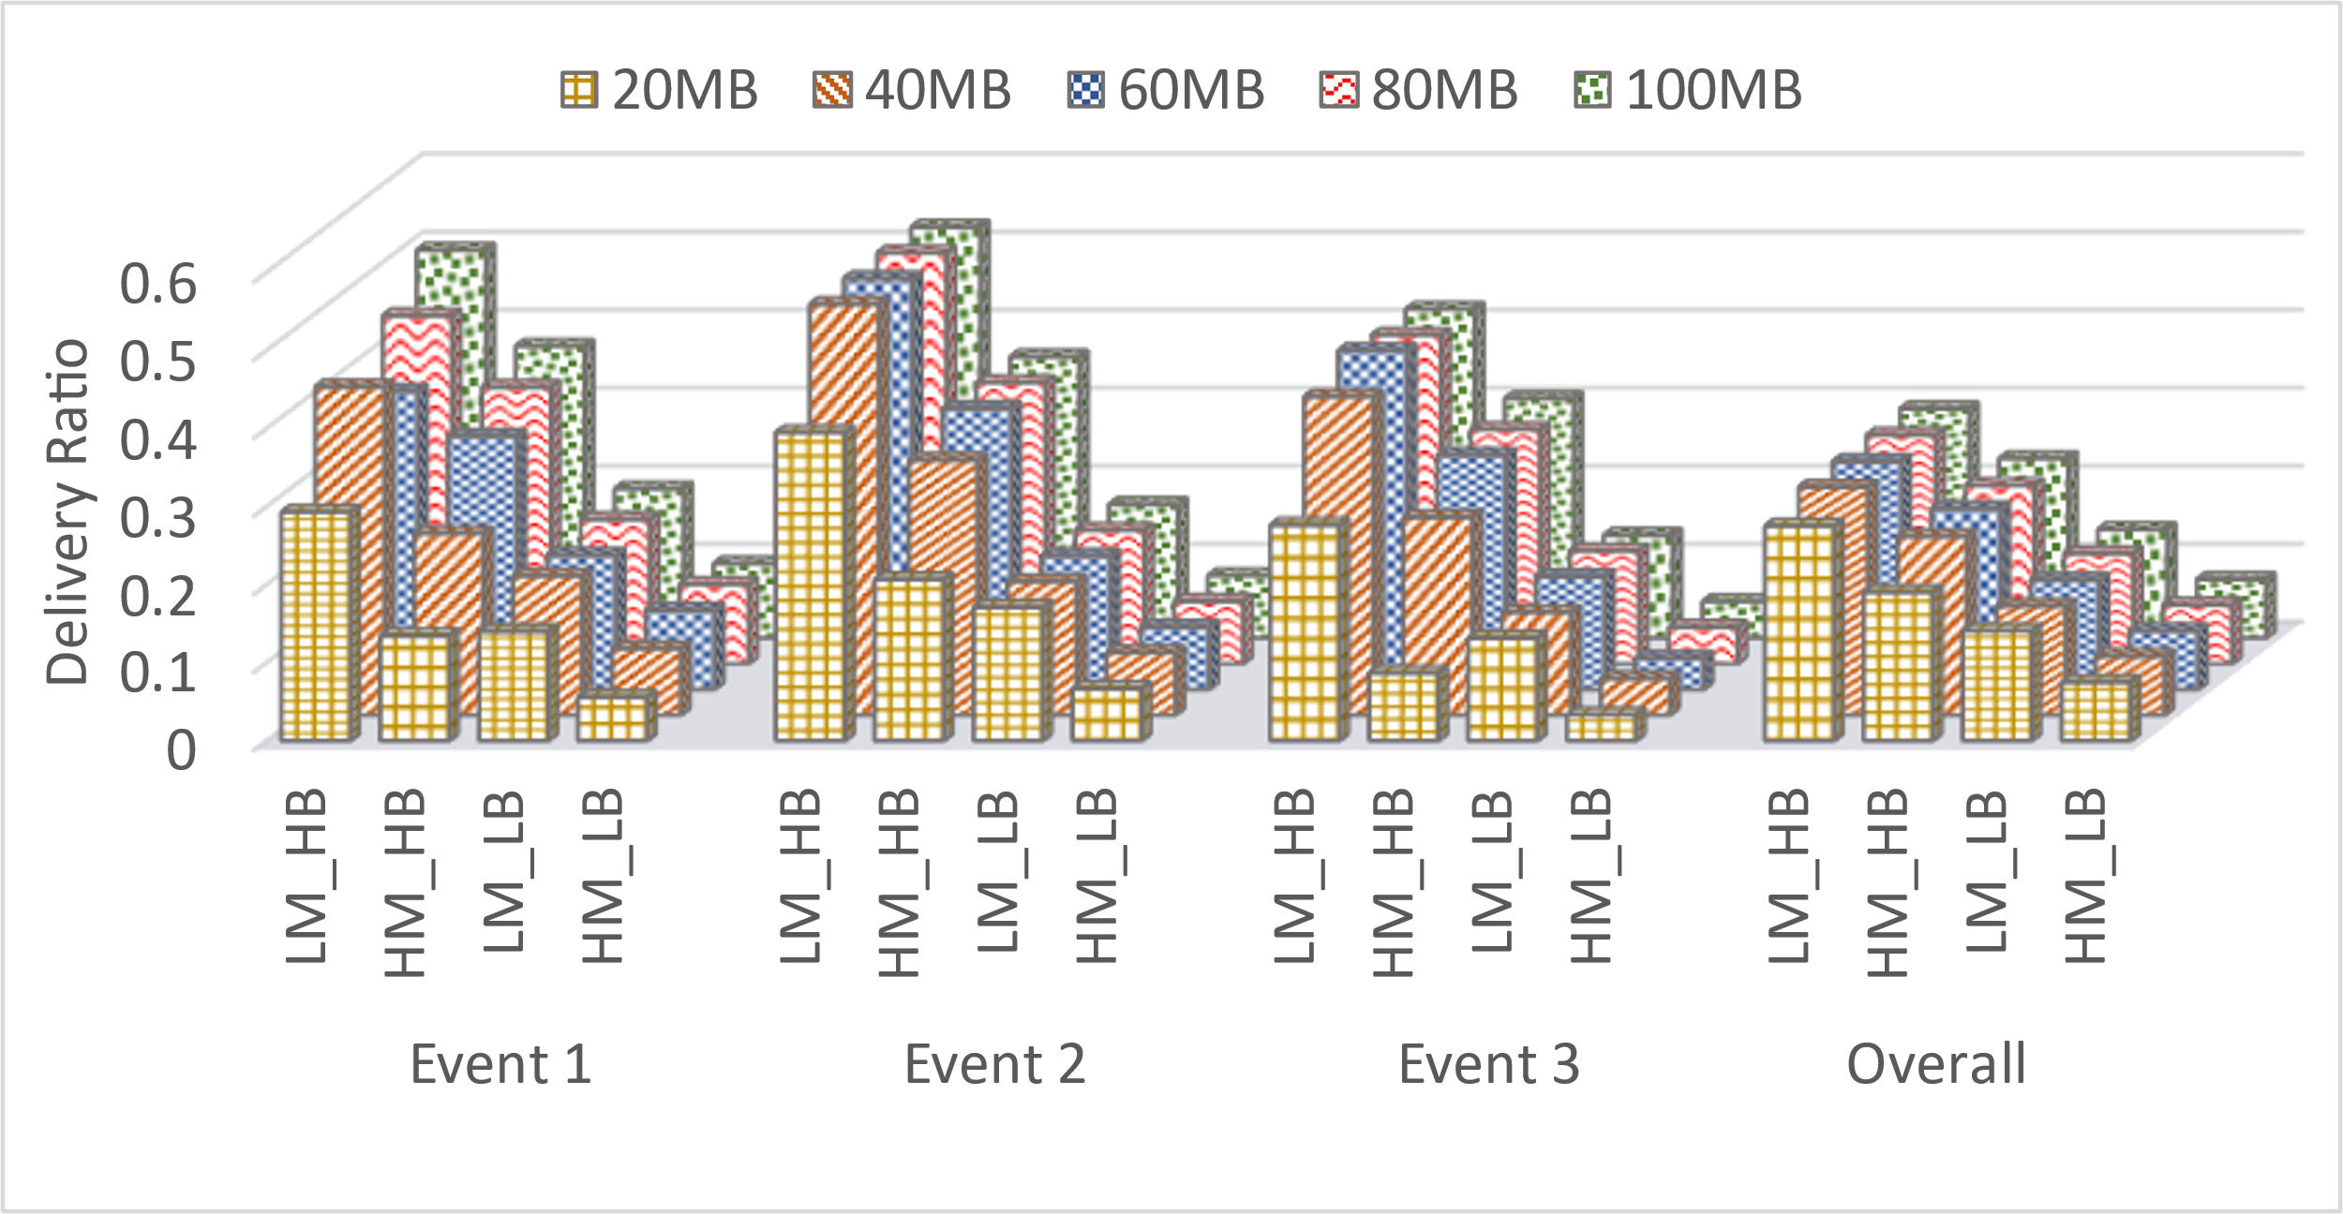
Throughput on varying resources: (AST)
Effect of varying network bandwidth, number of created message, and nodes’ buffer on delivery ratio. Here, HB (Higher Bandwidth) = 2MB/s, LB (Lower Bandwidth) = 128KB/s, and HM (Higher Message) = 36997 & 27078, LM (Lower Message) = 17889 & 13758 for AST & EPFL dataset respectively.

Slide 23
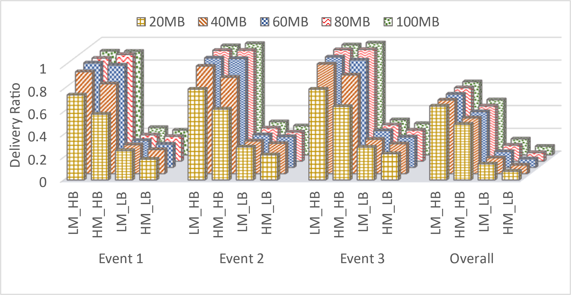
Throughput on varying resources: (EPFL)

Slide 24
Parse Tree Generation, Database setup and Tree edit distance
Parse Tree Generation
Tree edit distance
Database

Slide 25
Parse Tree Generation
A parse tree represents the structure of the sentence/phrase based on the grammar rules by identifying tokens denoting noun phrases, nouns, verb phrases, verbs, adjectives, determiners, prepositions, etc., in the sentence/phrase.
These tokens are based on parts-of-speech(POS) tagging in computational linguistics.

Slide 26
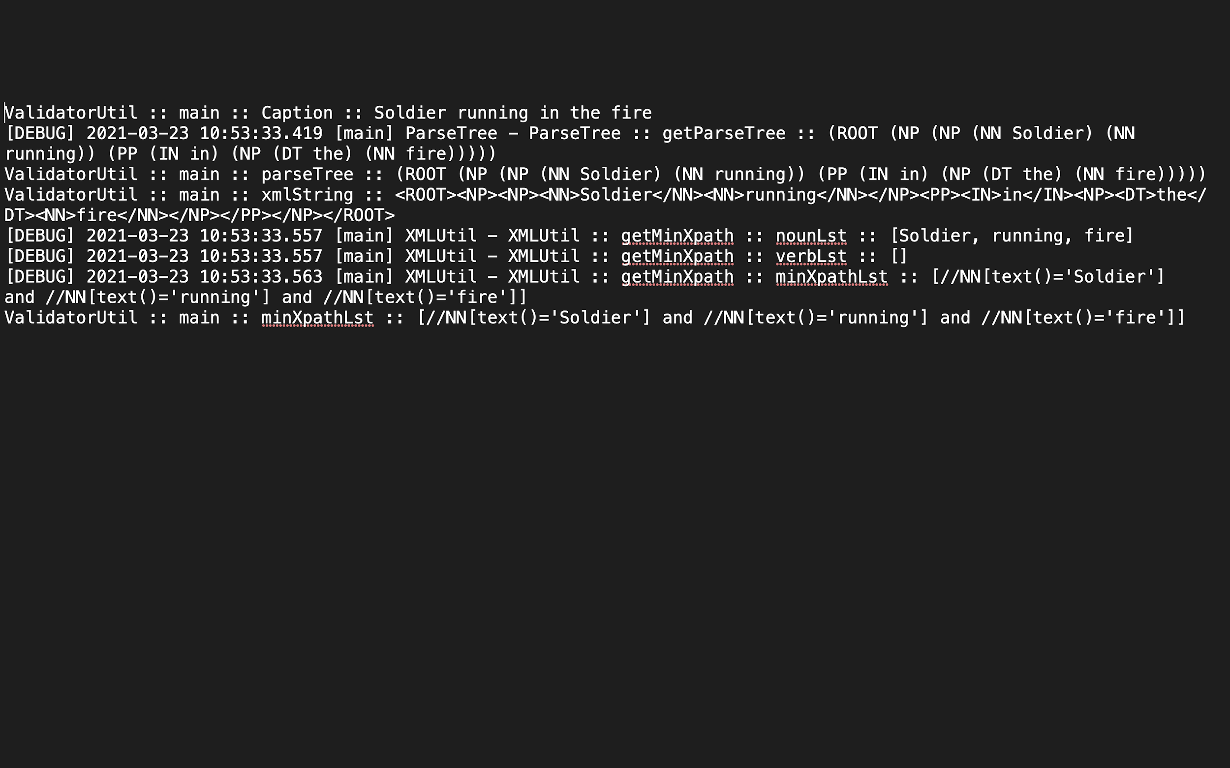
Parse Tree Generation – an example
Soldier running in the fire
Once the parse tree of the above form shown in the image is generated, we convert it into the below shown form by replacing ‘(‘ with ‘{‘ , ‘)’ with ‘} ’and trimming extra spaces.
{ROOT{NP{NP{NN{Soldier}}{NN{infront}}}{PP{IN{of}}{NP{JJ{red}}{NN{car}}}}}}

Slide 27
Tree edit Distance
Tree edit distance value - the minimum cost of transforming the source tree into the destination tree either by inserting, deleting or relabeling the nodes.
Apted Library helps us to compute the tree edit distance using it’s python implementation.

Slide 28
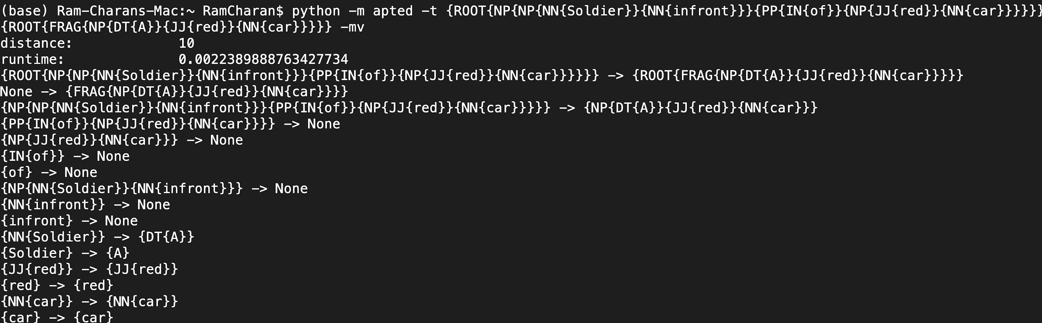
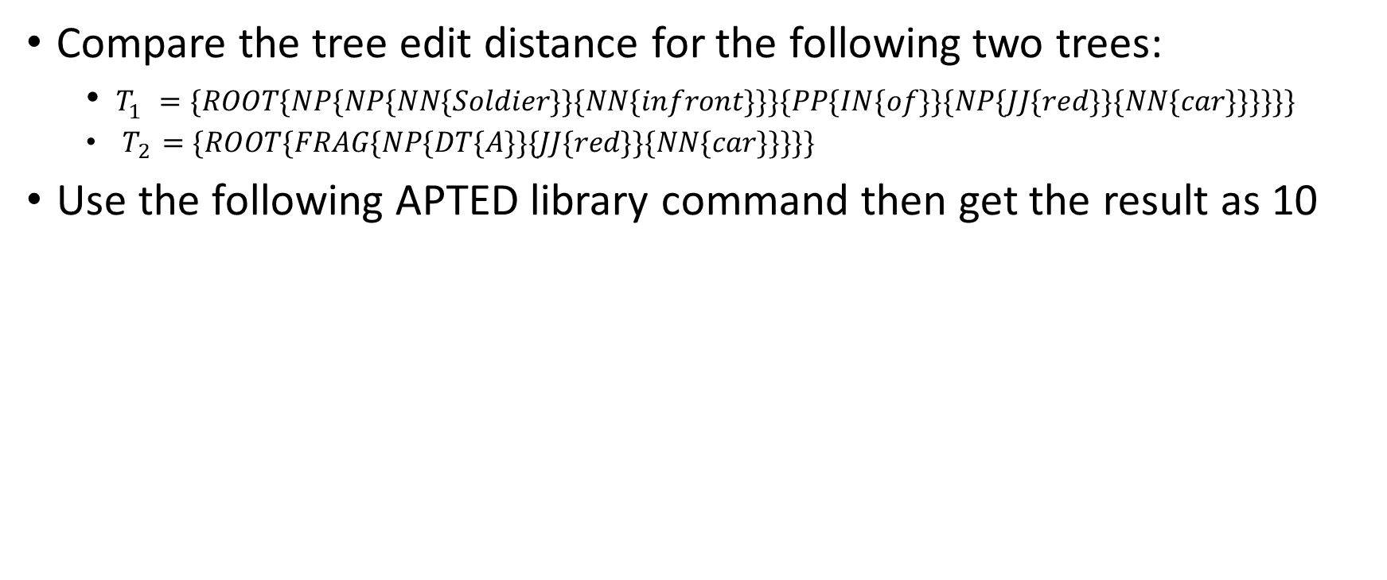
Tree edit Distance – an example
Compare the tree edit distance for the following two trees:
$T_{1} =\{ROOT\{NP\{NP\{NN\{Soldier\}\}\{NN\{infront\}\}\}\{PP\{IN\{of\}\}\{NP\{JJ\{red\}\}\{NN\{car\}\}\}\}\}\}$
$T_{2}=\{ROOT\{FRAG\{NP\{DT\{A\}\}\{JJ\{red\}\}\{NN\{car\}\}\}\}\}$
Use the following APTED library command then get the result as 10

Slide 29
Database
We choose MySQL database to store parse trees of the captions.
Since our end goal is to implement these on mobile devices, choosing MySQL would enable us to use MySQL lite database on the mobile devices making it more hassle free.

